Slide 1
Customize this slide for your business!
[Insert Brand Name] + Snapchat

Slide 2
What is Snapchat
Snapchat lets users live in the moment by allowing them to easily talk with friends, view Live Stories from around the world, and explore news in Discover. Snaps live on the app for 24 hours, making it a unique opportunity for experimentation in both ad style and community engagement.

Slide 3
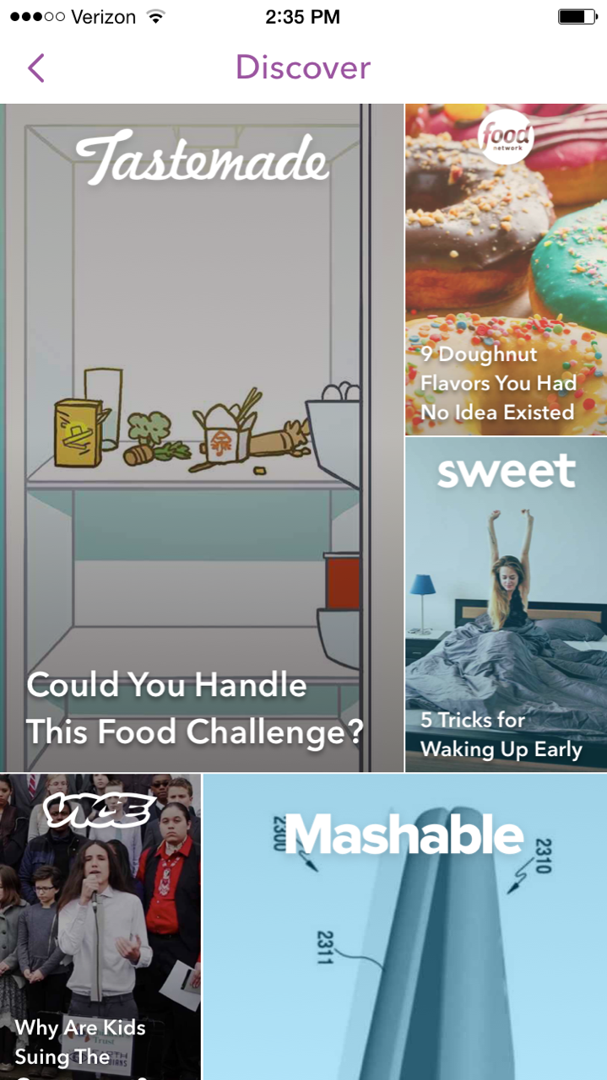
Snapchat Stats
• Daily Active Users: 150+ million
• Average Time Spent on Snapchat: 20-30 min.
• Snaps sent per day: 400 million
• Snaps sent per second: 9,000
• Snapchat Videos Watched Per Day: 10 billion
Statistics collected from: http://snapchat.com/ads

Slide 4
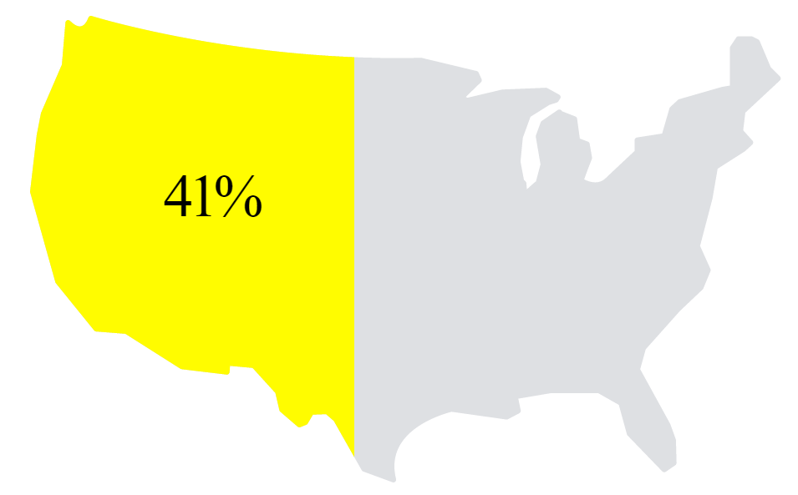
Snapchat Reach
• Reaches ~41% of 18-34 year-olds in the U.S.
• 86% of users are between 13-37 years old
• 54% of Snapchat users snap every single day
41%
Statistics collected from: http://snapchat.com/ads

Slide 5
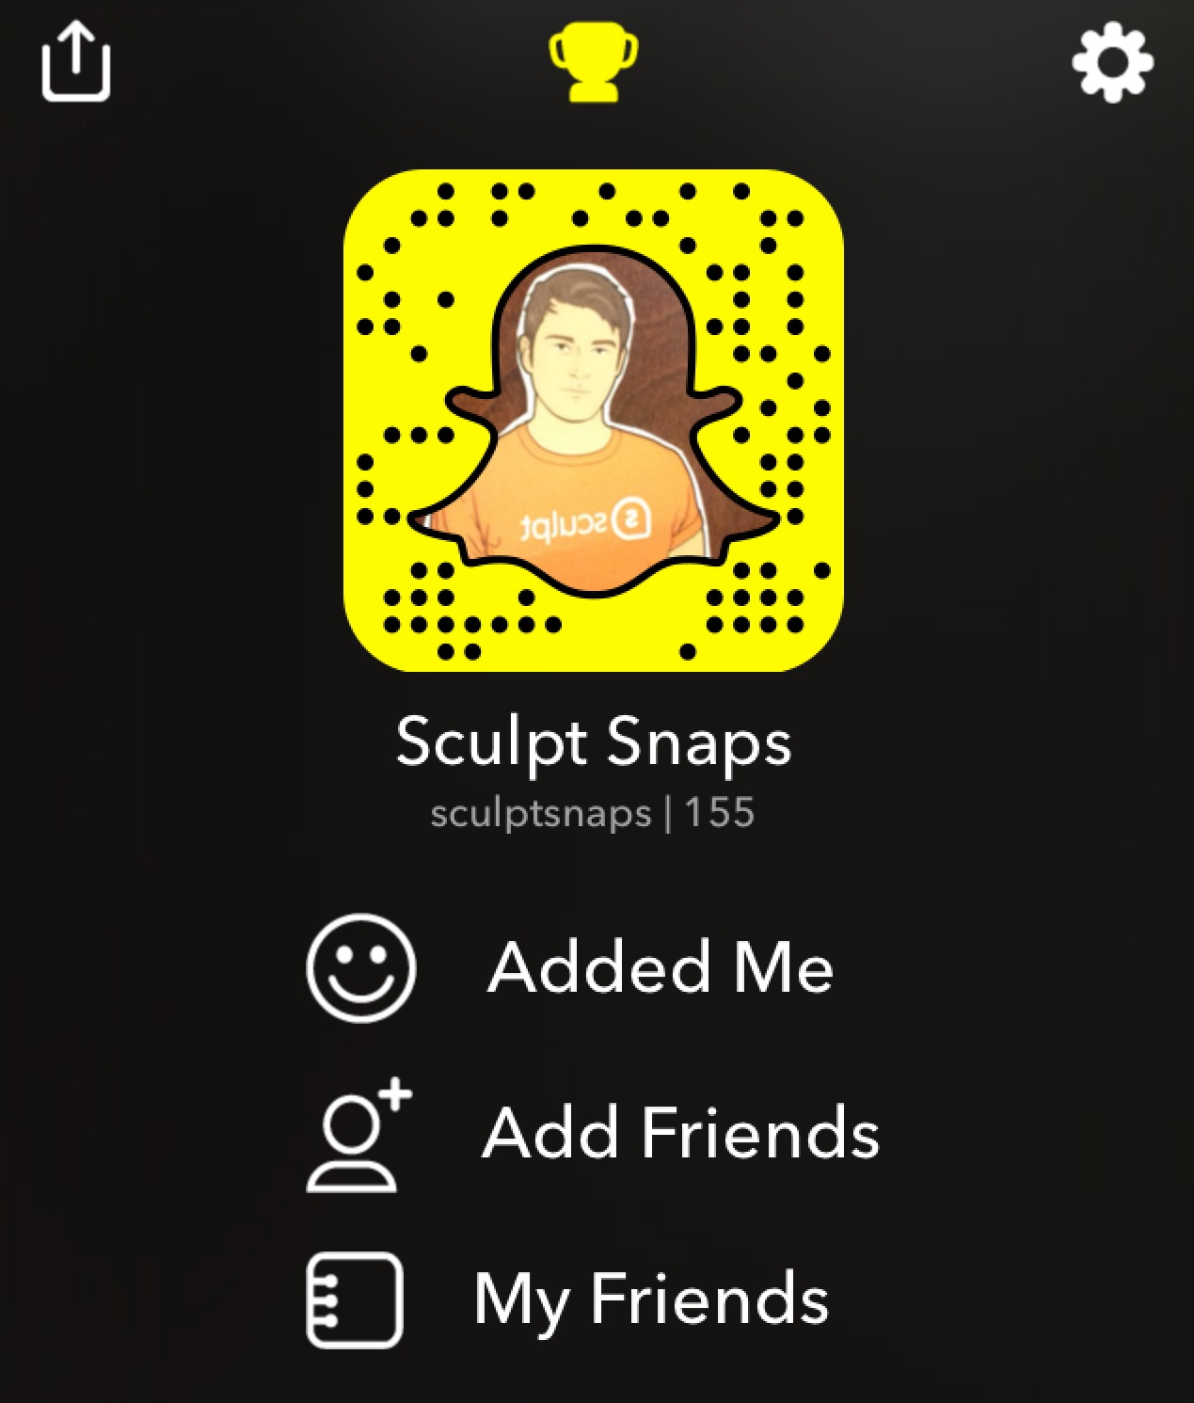
How it Works
• Set up an account (It’s free!)
• Post Snapcode on our social media accounts to encourage
current fans to follow us
• Send Snaps directly to individual followers
• Post Snaps on our story for our followers to discover
• Create a customized Geofilter for locations and live events

Slide 6
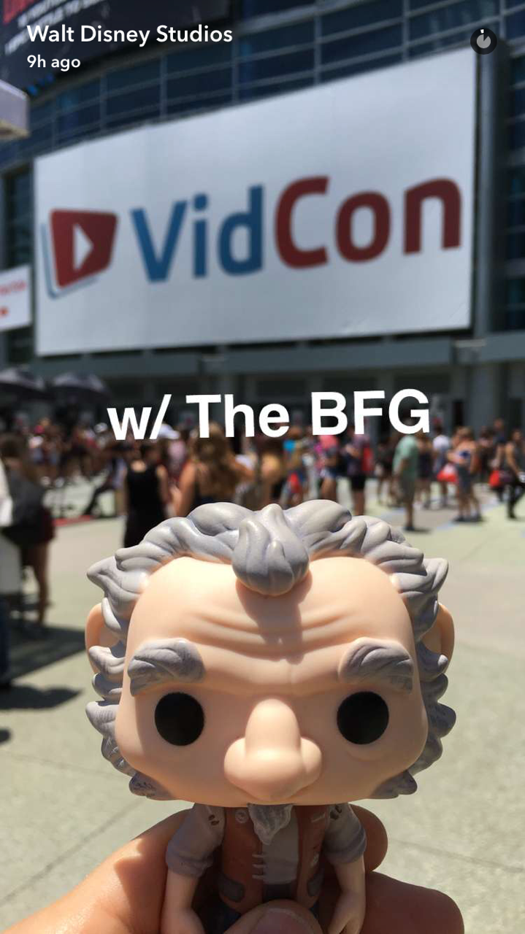
Snapchat Benefits
• Two-way conversation with our brand and users
• Encourages users to engage/create content with our brand
• The entire screen is our creative canvas
• Can upload content or use intuitive, built-in tools
• Every new update brings us to the top of our followers’ feeds

Slide 7
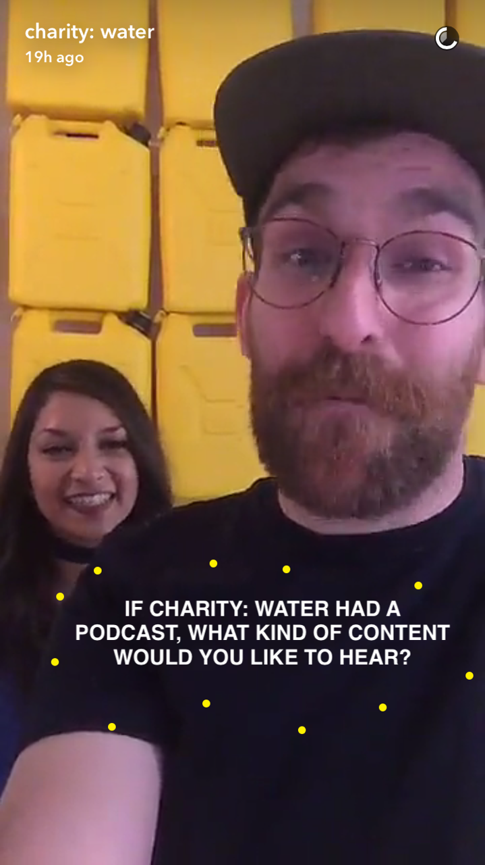
Who’s Doing it Well
Charity Water
• Excels at audience engagement — building an authentic
voice behind the brand
• Encourages followers to screenshot their input on blogging
and podcast decisions, so they can create content their
fans care about and are interested in
• Throws in subtle calls to action (ways to donate) after
giving a lot of audience-driven content. Never feels like the
CTA is the main reason for them to be on Snapchat.

Slide 8
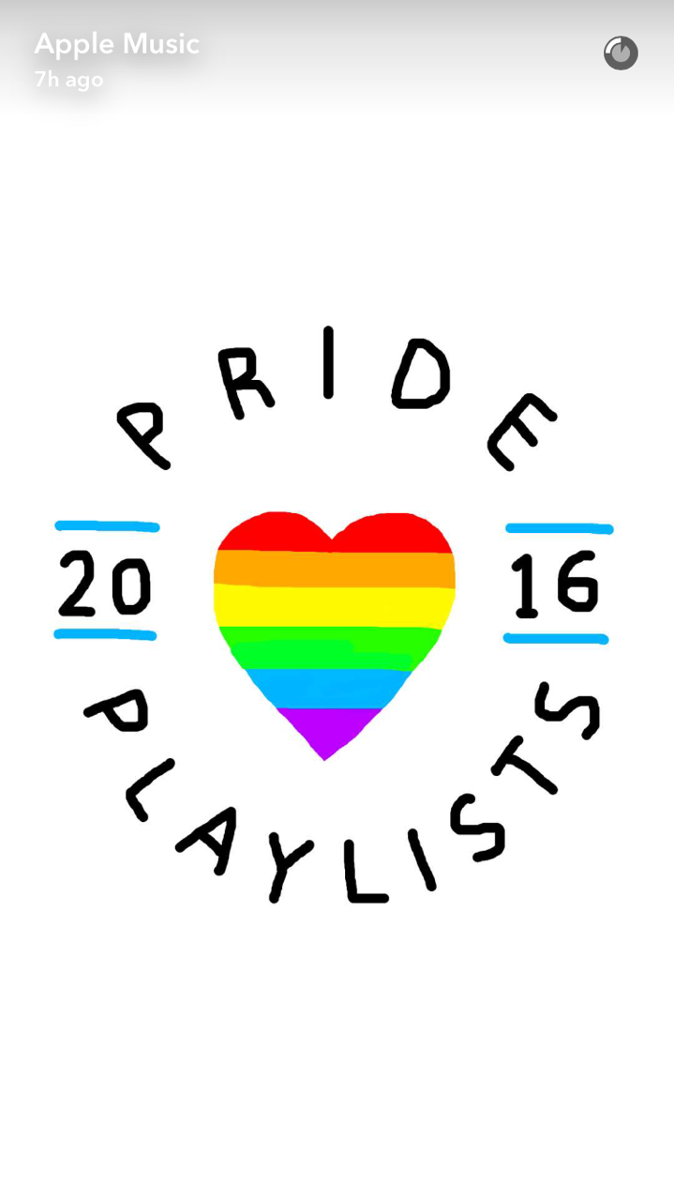
Who’s Doing it Well
Apple Music
• Releases elaborately drawn and visually pleasing stories
• Apple uses many layers to engage with their followers
(drawings, emojis, text, video, music)
• Prompts users to explore further on their website

Slide 9
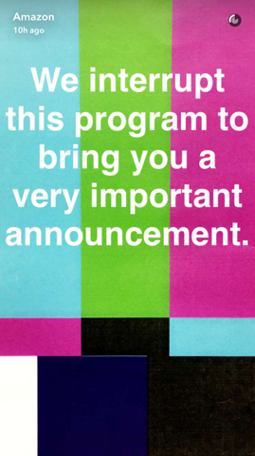
Who’s Doing it Well
Amazon
• Provides exclusive rewards to followers, coupons that
drive consumers to website and prompt sales
• Builds excitement through giveaways
• Incorporates promotional content between giveaway posts

Slide 10
Relative Cost
• Low production cost; it’s free to post; only hard cost is time
it takes for team to produce stories and post them
• Geofilters start at $5 — the price escalates as our
geofence timeline expands*
• We can partner with influencers to amplify reach and
pay per snap, campaign, or conversion
• Large-scale Snapchat ads average $50,000+ for
national Geofilters or Lenses
*A geofence around the area of our office (43,251 Sq Ft) is $5 for 1 hour. For the 2 blocks around our office (304,167 Sq Ft) it costs $11.41 per hour. We can cut down on costs for geofilters by only using them during business hours, or specific hours in the day when we want visibility.

Slide 11
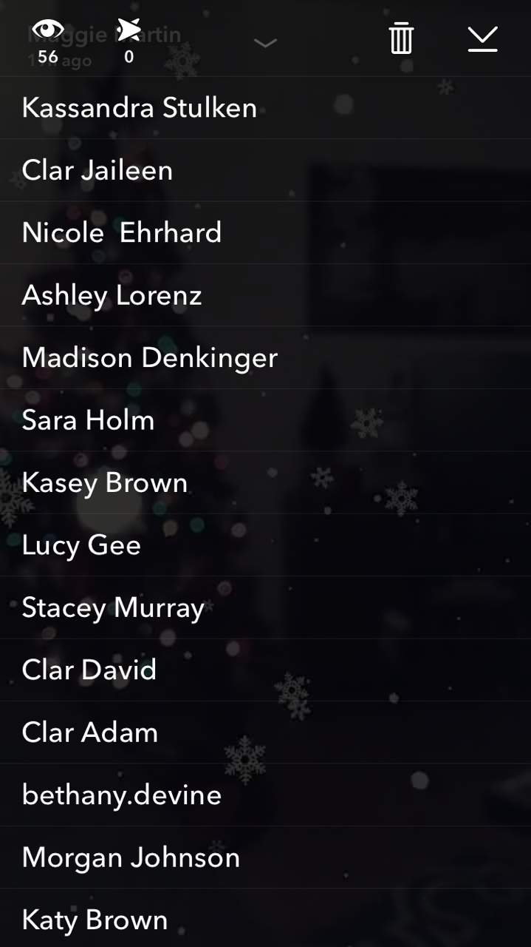
Measuring Success
• There are no measurement tools for brands within Snapchat (yet).
Third party apps like Delmondo and Snaplytics have solutions.
• We can track engagements by the number of people who:
- Send us snaps directly
- View individual snaps
- View a % of / our entire story
- View or use our Geofilter
- Screenshot our snaps
• We can track conversions by the number of people who:
- Redeem the limited-time offers we snap
- Visit the custom URL we snap
- Complete our intended call-to-action
* http://marketingland.com/snaplytics-launches-snapchat-analytics-196692

Slide 12
The Competitor
Instagram Stories
• Still an emerging feature, Snapchat is still top-of-mind for
real-time video and photo sharing
• While Instagram has more users, the daily active user ratio
of Snapchat users is much higher
• These users spend 25 to 30 minutes on Snapchat.
Instagram users spend an average of 21 minutes in the app
per day. There are not metrics for time spent on stories.
*Statistics collected from: http://www.businessinsider.com/people-are-sharing-less-on-instagram-2016-6

Slide 13
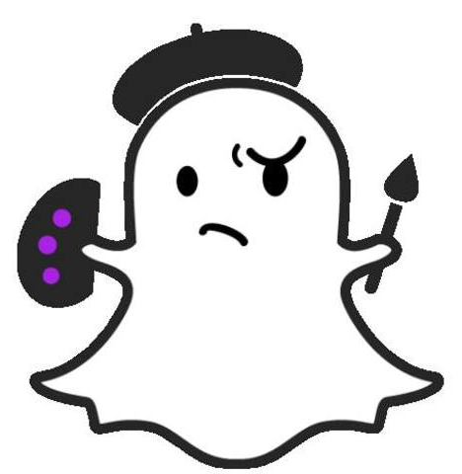
Should We Snap
Why is it a fit for our business?
Ex. Answer: We’re serious about adding value, but we don’t take ourselves too seriously; Snapchat users appreciate this!
How can we benefit?
Ex. Answer: It’s easy-to-use; it won’t break the bank to experiment; we can run timely, exclusive promotions to an engaged audience; we can showcase our culture; we can solicit feedback through one-to-one conversations with our followers.
What important audiences can we reach?
Ex. Answer: We can get the attention of a younger, early-adopting segment of our customer base that is harder to reach on more mature channels such as Facebook.
Customize this slide for your business!

Slide 14
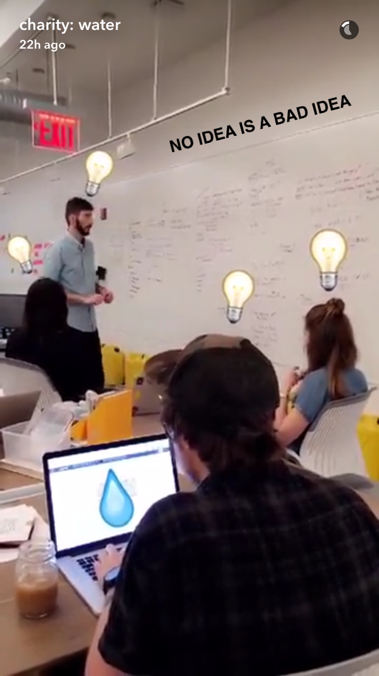
Let’s Get Snapping
What kind of Snaps can our business produce?
Ex. Answer: The options are endless! Through images, stories, video, and emojis, we could promote our products, provide behind-the-scenes access, share events happening in real-time, answer questions from customers, and more!
What can we promote on Snapchat?
Ex. Answer: We can promote our sales, our culture, our events, our employees, our fans, and our customers.
Customize this slide for your business!

Slide 15
Snapshot of Takeaways
• Moves us closer to our customers
• Supports our brand marketing strategy
• Relevant and rapidly growing communication channel
• Minimal investment required to get started
• We can still be early to the game and a leader in our industry
• Easy to integrate into our day-to-day work
Customize this slide for your business!

